Slide 1




Longitudinal Links Between Work Experiences and Marital Satisfaction in African American Dual-Earner Couples
‘When Work Permeates Into One’s Family and Personal Life’
Xiaoran Sun, Susan M. McHale, Ann C. Crouter, & Damon E. Jones
Department of Human Development and Family Studies
The Pennsylvania State University
Notes:
Marrying theory and method in the study of African American marriages

Slide 2

Background
African American couples:
Unique history in labor market
Marital relationship dynamics are understudied
Low rates of marriage; low levels of marital satisfaction; High rates of divorce (Bulanda & Brown, 2007)
Research Question:
How are African American spouses’ work experiences associated with their marital satisfaction?

Slide 3

Background
Theoretical grounding:
Family systems perspective (Cox & Paley, 1997)
Families are open systems, subject to influences from the larger environment (e.g., work environment)
Influences of family processes are dependent on personal characteristics (e.g., gender)
Reciprocal influences between family members
The work-home resources model (ten Brummelhuis & Bakker, 2012 )
Work-to-home conflict: work demands (e.g., work pressure) can impede functioning at home
Work-to-home enrichment: work resources (e.g., work autonomy and flexibility) can improve home outcomes
Notes:
To answer this question, we hold a family systems perspective, which I’ll introduce in details. Also, we based our assumptions on the work-home resources model. There are many propositions in this model, among which two of them are...

Slide 4
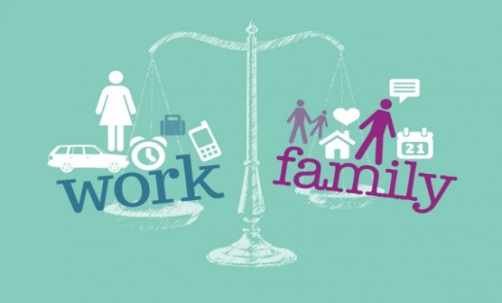
Background
Work as a context for family systems:
Spillover effect
work
marital satisfaction
Notes:
According to the family systems perspective, workplace as a context of family systems, can have spillover effects on family functioning.
Use the language “my own work…” “my own marital satisfaction”

Slide 5

Background
Family members reciprocally influence one another
Crossover effect
Actors’ work
Actors’
marital satisfaction
Partners’ work
Notes:
Beyond the effects of spillover, partner effect… such that my partner -> my marital satisfaction

Slide 6

Background
Family systems processes are mutually influential
Interactive effects
Actors’ work
Actors’ marital satisfaction
Partners’ work
Notes:
Say “combination” and “differences”

Slide 7

Hypothesized effects:
Family systems perspective
1. Spillover effects
2. Crossover effects
3. Interactive effects
4. Effects differ by gender
Method:
Actor-partner interdependence model (APIM)
1. Actor effects
2. Partner effects
3. Interaction between actor and partner effects
4. Gender moderation
Longitudinal data with repeated measures
Over-time APIM, estimated with multilevel modeling (MLM)
(Kenny & Donnellan, 2012; Kenny, Kashy, & Cook, 2005)
Theory
Method
Notes:
The effects that we are interested in examining match the APIM method.
ADD FAMILY SYSTEMS TO THE PINK THEORY BOX AND APIM TO THE BLUE METHOD BOX

Slide 8
Method
Penn State Family Relationships Project
(co-PIs: Susan M. McHale & Ann C. Crouter; NICHD R01-HD32336)
164 African American dual-earner couples
Three annual home interviews, spouses interviewed separately
Work Demands
work pressure (9-item, 4-point, e.g., “There are always deadlines to meet”; Moos, 1986)
Work Resources
work self-direction (20-item, 4-point; domains-- autonomy, control over others, job complexity & flexibility, lack of repetition; Lennon, 1994)
Marital Relationship Characteristics
Marital satisfaction (8-domain, 9-point, e.g., couple communication, division of housework; Huston, McHale, & Crouter, 1986)
Covariates
Duration of living together, income, education

Slide 9
Analytic Plan
MLM for longitudinal dyadic data
Two-level models
Level 1: Time-varying work variables
Level 2: Person-mean work variables
Estimating the effects
Main effects: actor; partner (Model A)
Two-way interaction with gender (Model B)
Two-way interaction between actor and partner (Model C)
Three-way interaction between actor, partner, and gender (Model D)
(Kenny et al., 2005; Laurenceau & Bolger, 2005)
Notes:
NOTE THAT GENDER HAS NOT YET BEEN INTRODUCED SO GOOD TO SAY SOMETHING ABOUT IDEAS ABOUT GENDER HERE IF ANY TIME
For longitudinal dyadic data analysis, we cannot use three-level models, because three-level models
NOT typical three-level models
intercepts between two partners’ constrained to be positively correlated
two members’ errors at each time constrained to be zero

Slide 10

Results: Effects of Work Pressure
Actor main effects (spillover)
Time-varying level (γ = -.29, SE = .11, p < .05)
Controlling for their cross-time average, on occasions when spouses reported more work pressure than usual, they also reported lower marital satisfaction than usual
Person-mean level (γ = -.51, SE = .16, p < .01 )
Spouses’ own work pressure, averaged across time, was negatively associated with their the cross time average of marital satisfaction
Partner main effects (crossover)
N.S. at both levels

Slide 11
Results: Effects of Work Pressure
Actor X Partner X Gender interaction:
At person-mean level, γ = .41, SE = .21, p < .05

Slide 12
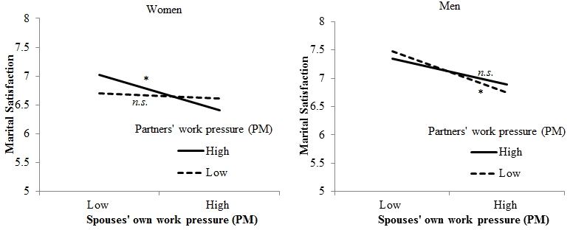
Results: Effects of Work Pressure
Women
Men
For women: The negative link between women’s own work pressure and their marital satisfaction was exacerbated by their partners’ high work pressure - an amplification effect
For men: The negative link between men’s own work pressure and their marital satisfaction was more evident when their partners had low work pressure – a comparison effect.
Notes:
In other words, bigger differences between spouses in work pressure had negative implications for husbands
Me with high work pressure whose wife had low pressure were partifuparly dissatisfied with their marriage when
Bigger plot

Slide 13
Results: Effects of Work Self-Direction
Actor main effects (spillover)
N.S. at both levels
Partner main effects (crossover)
N.S. at both levels
Actor X Partner interaction effect
At time-varying level, γ = 2.29, SE = .98, p < .05

Slide 14

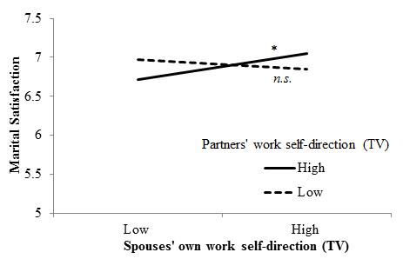
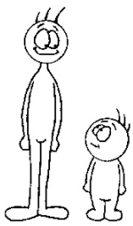
Results: Work self-direction as predictor
Actor X Partner interaction (Time-varying level)
On occasions when partners’ work self-direction was higher than usual, spouses’ work self-direction was positively associated with their marital satisfaction –consistent with both amplification & comparison patterns
Notes:
Cumulative benefits
Ask for thoughts
Combination of both being high is better than one being high
Comparative is about being different- can be good or bad
compensatory

Slide 15
Contributions
Illuminate how work permeates the marriage relationships of African American couples
Work-to-home conflict
Amplifying pattern for women (women are more susceptible to partners’ emotion transmission)
Comparison pattern for men (violating the egalitarian norm)
Work-to-home enrichment
Resources only beneficial when both spouses share them

Slide 16
Contributions
Implications for the work-family literature
A combination of family systems theory and work-home resources model
Dyad as the unit of analysis
Interactions between spouses’ work experiences
Implications for intervention
Interventions to enhancing work experiences may support African American marital relationships
Improve both spouses’ work to optimize effects

Slide 17
Contributions
Application of APIM informed by family systems tenets
Innovation: provide substantive support for actor-partner interactions in APIM
Theory
Method
Notes:
Most prior – collected data from only one member of a dyad; when collecting dyad, the focus was on individuals, not the dyad

Slide 18
‘When Work Permeates Into One’s Family and Personal Life’
Thanks!
Questions & Suggestions
xbs5014@psu.edu
Acknowledgement to:
Eunice Kennedy Shriver National Institute of Child Health and Human Development (Grant R01-HD32336)
The National Science Foundation
(IGERT Grant DGE-1144860, Big Data Social Science)
Sun, X., McHale, S. M., Crouter, A. C, & Jones, D. E. (in press) Longitudinal links between work experiences and marital satisfaction in African American dual-earner couples.
Journal of Family Psychology

Slide 19
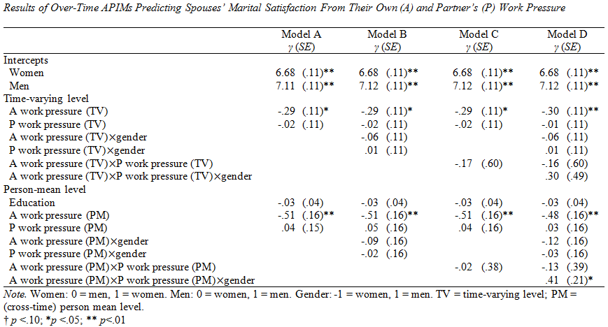
Results: Effects of Work Pressure

Slide 20
Results: Effects of Work Pressure

Slide 21
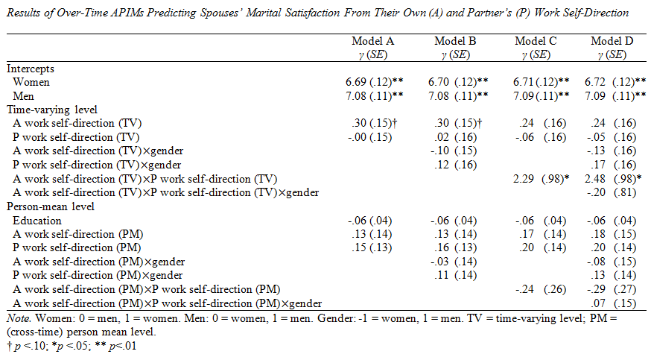
Results: Effects of Work Self-Direction

